Slide 1
Proxy Wars
A war in which the Cold War superpowers (the US and USSR) supported opposing sides or fought directly against the side supported by the rival superpower.

Slide 2
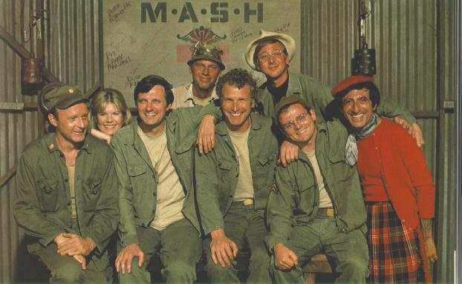
The Korean War
1950 –1953
While the hostilities in Berlin remained essentially non-violent, hostilities did erupt in Asia, which became a proxy war between the Communist and American forces fighting the Cold War

Slide 3
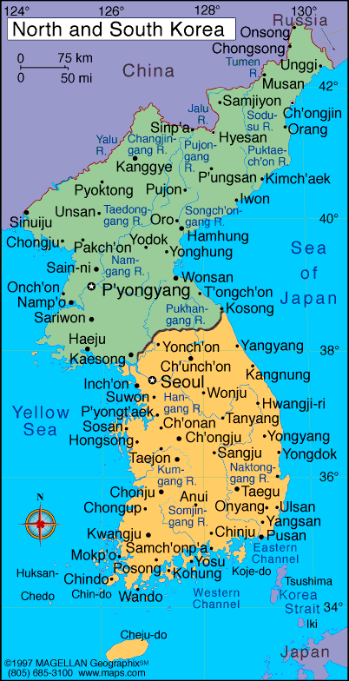
Korea had been a Japanese colony until WWII, then temporarily split at 38th parallel between USSR and USA

Slide 4
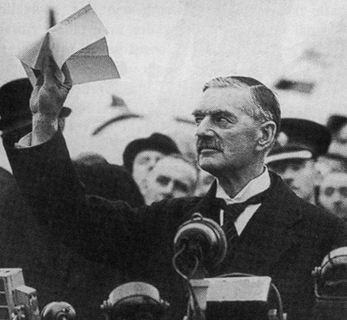
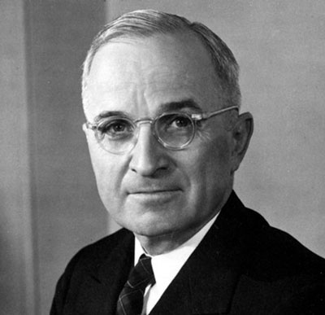
Communist backed North Korea invaded South Korea in an attempt to reunify the peninsula
Thought by Americans to be backed by the Soviets, so Truman Doctrine was used to justify getting involved
Truman was afraid of repeating the mistakes of Chamberlain

Slide 5
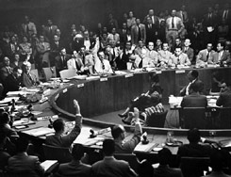
Truman wanted international justification for involvement, so he went to the U.N.
first act of peace making
Soviet Union was boycotting the Security Council in protest of China’s seat not being given to the new communist government, so they were unable to veto the motion

Slide 6
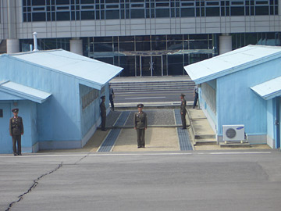
He then pushes the North Koreans to the Chinese border (against Truman’s instructions) This increased Chinese involvement.
McArthur requests the use of nuclear weapons, Truman says no
General McArthur leads a UN backed force including Canadians. Pushes back the North Korean army to the 38th parallel.
He explained he would drop between 30 and 50 atomic bombs- strung across the neck of Manchuria, and spread behind us, from the Sea of Japan to the Yellow Sea-a belt of radioactive cobalt-for at least 60 years there would be no land invasion of Korea from the North. The Russians, he claimed, would be intimidated by this and do nothing
Fighting continues for two more years, until an armistice is signed in 1953.
North and South Korea are still officially at war today, with a large number of US troops maintaining the South Korean border.

Slide 7
Vietnam
https://www.youtube.com/watch?v=aoXySB-WlZE

Slide 8
Foreign Rule In Vietnam
France conquered Vietnam in 1880s – 1940, WWII - Japan takes over
French fight to regain control in 1946
Nationalist Independence Movement (Communist) - leader: Ho Chi Minh
USA stayed out: Ho Chi Minh stated he only wanted independence
1949 Mao Zedong won control of China and USA fears Minh is China’s puppet government
USA pays France $ Millions/year to help with the war and set up rival government in South.
Eventually, French are crushed at the battle of Dien Bien Phu (1954)
Geneva Peace Conference: French agreed to leave and Vietnam was left divided

Slide 9
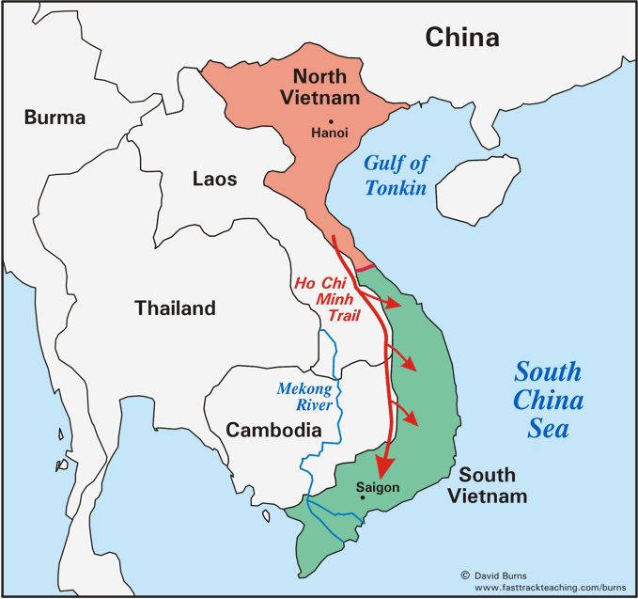

Slide 10
INDEPENDENCE AND CONTAINMENT
1956 Elections for unified government prevented because of fears of communist takeover
1957 Ho Chi Minh uses sabotage and terrorism to attempt to control Vietnam (Vietcong)
President Eisenhower: Domino Theory
US afraid if one country fell to communism, other south-east Asian nations would fall
Eastern Europe fell to Russia, Asia would fall to China
= money, weapons and soldiers used to train South Vietnamese, eventually US starts to fight directly
Russia and China responded by supporting the North

Slide 11
The Vietnam War (1957?-1975)
Guerilla warfare was main tactic
USA became frustrated and began using Agent Orange / Napalm
Innocent villagers were often victims (My Lai Massacre)
Role of media
By the late 1960s Americans could no longer stand to see war on their TV = widespread protests (Kent State)
1969 Richard Nixon “Vietnamisation” (strengthen South Vietnamese troops)
US withdrawal offered for North cease-fire
North slow to respond so the US started carpet bombing again to persuade them
1973 Agreement was reached and US leaves
1975 War ended with Communist capture of Saigon – Ho Chi Minh City
https://www.youtube.com/watch?v=Y2IcmLkuhG0

Slide 12
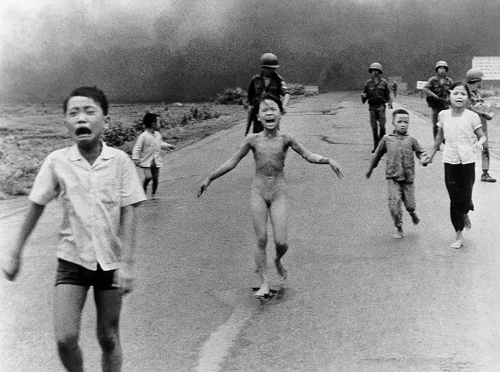
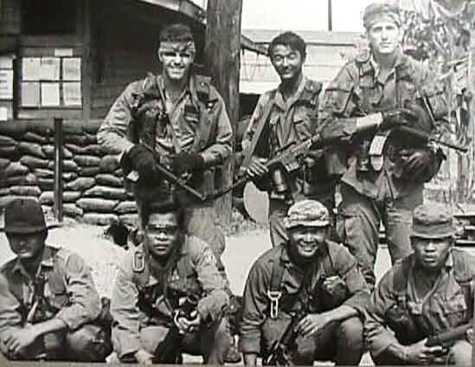
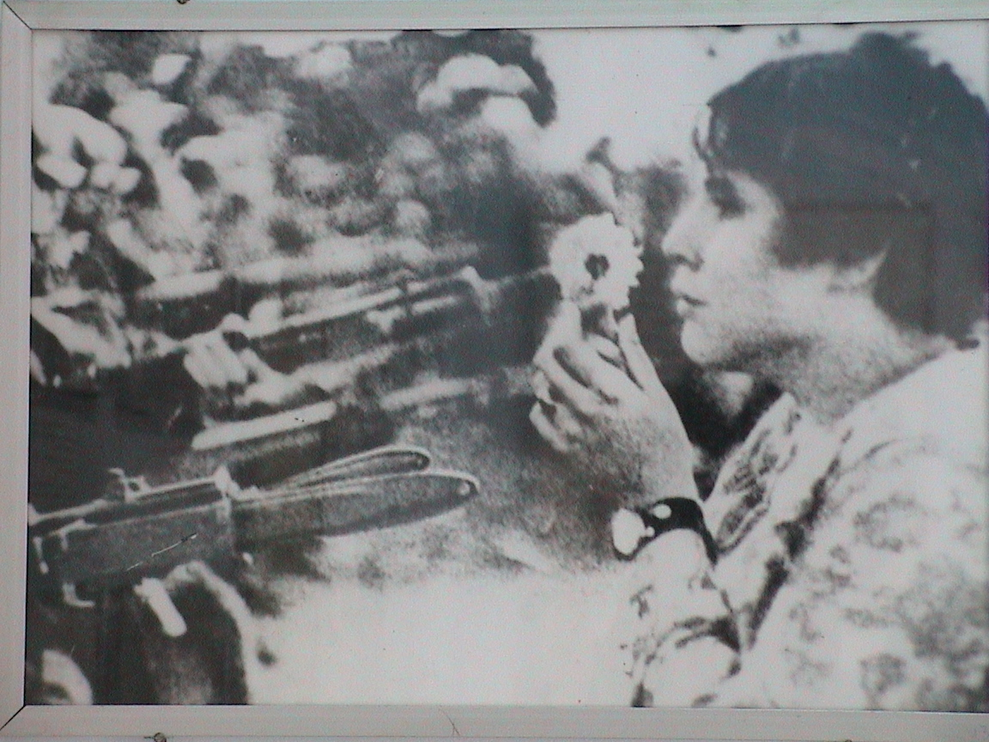
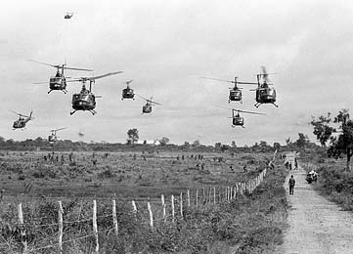
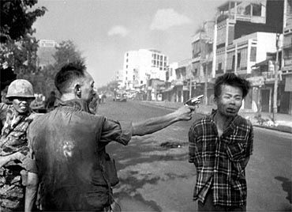
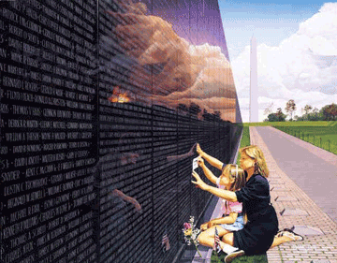
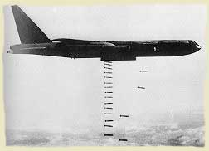

Slide 13
The cost
Containment had failed
1,800,000 people killed
(55,000 Americans)
at a cost of $150 Billion

Slide 14
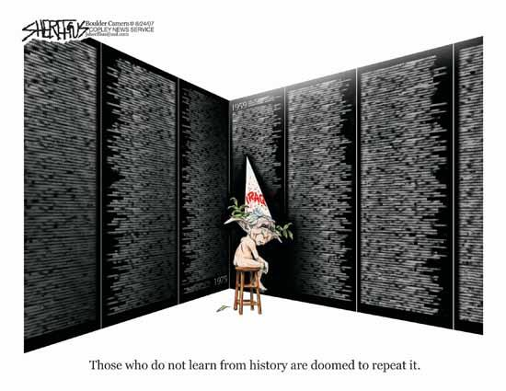

Slide 15
Canada refused to directly participate in the war, although some Canadian troops joined the US military, and Canada took in many draft dodgers (group in B.C. wanted to erect a monument to them, but the United States protested). Long after the war deserters were granted an amnesty and allowed to return to the US
Movies: Apocalypse Now, Platoon, The Deer Hunter, Hamburger Hill, Full Metal Jacket, Good Morning, Vietnam, Born on the Fourth of July, the Rambo films, We Were Soldiers, as well as Jacob's Ladder

Slide 16
Born down in a dead man's town
The first kick I took was when I hit the ground
You end up like a dog that's been beat too much
Till you spend half your life just covering up
Born in the U.S.A.
Got in a little hometown jam
So they put a rifle in my hand
Sent me off to a foreign land
To go and kill the yellow man
Come back home to the refinery
Hiring man says "Son if it was up to me"
Went down to see my V.A. man
He said "Son, don't you understand"
I had a brother at Khe Sahn fighting off the Viet Cong
They're still there, he's all gone
He had a woman he loved in Saigon
I got a picture of him in her arms now
Down in the shadow of the penitentiary
Out by the gas fires of the refinery
I'm ten years burning down the road
Nowhere to run ain't got nowhere to go

Slide 17
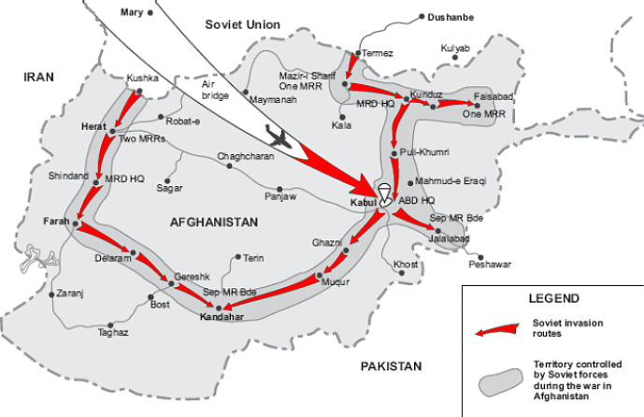
Afghanistan

Slide 18
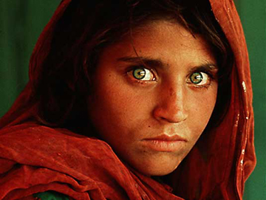
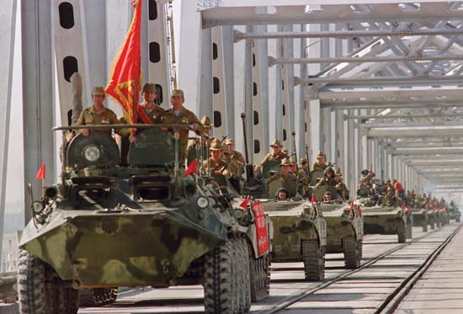
Expansionism
Afghanistan
The Shah is deposed and communist- friendly government takes over
Several coups follow
Christmas 1979 - USSR “invited” to help restore stability
Atrocities committed by Soviet army (and Cold War relations) = US covert involvement (along with Pakistan and Saudi Arabia)

Slide 19
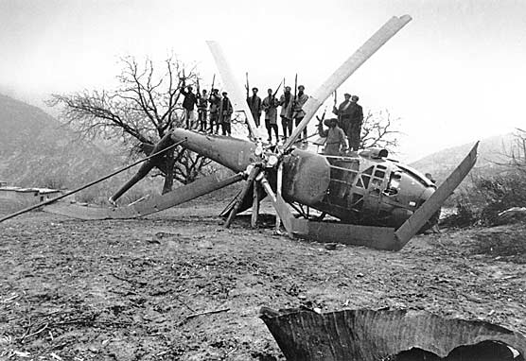
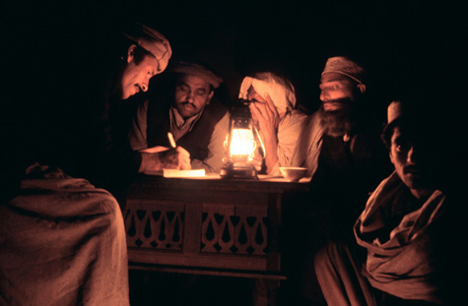
Containment
Afghanistan cont.
Mujahideen fighters (like Osama Bin Laden) trained and supplied by US to cripple Soviet efforts
USSR’s version of the Vietnam War – major impact on their economy and global prestige (Olympic Boycott)
1989 – Gorbachev removes all Soviet troops – UN in charge of reconstruction
Little interest now that it is not a pawn in Cold War
Taliban take over most of the country - reactionary
Support Al Qaeda fighters - 9/11

