Slide 1
The Cold War
Conditions of extreme tension and hostility with no military action

Slide 2
Social 20 Recap
How did WW2 end in Europe?
Who was where?
Who would want what?
IF YOU REMEMBER NOTHING, TRY TO USE YOUR BRAIN TO ANSWER BEST YOU CAN

Slide 3
IMPORTANT CONFERENCES
Basically the start of the cold war.
Feb 1945 Yalta | Stalin, Roosevelt and Churchill | Discuss partition of Germany into 4 zones of occupation, reparations, Polish post-war boundaries, and the entrance of USSR into war with Japan.
July 1945 Potsdam (what else was happening at this time?) | Stalin, Truman (Where did Roosevelt go?) and Atlee (where did Winston go?) | Discuss outstanding issues – disagreement between U.S. and U.S.S.R. over the treatment of Germany and Poland

Slide 4
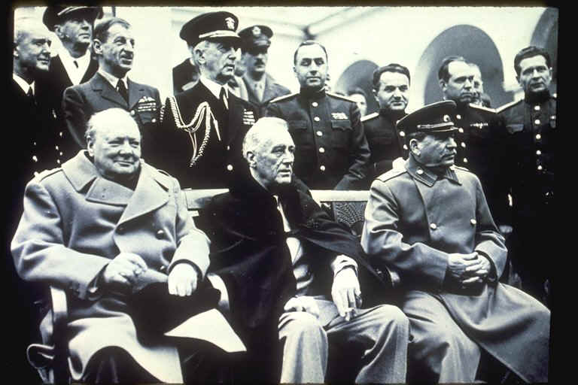
https://www.youtube.com/watch?v=WOVEy1tC7nk
Allies liberate Italy –
take control of government
Leads Stalin to believe he can control the governments of Eastern European nations he liberated
Spheres of influence
Divided Germany important to USSR
fought two major wars in less than 50 years
Soviet losses were almost 30 million in WW II
Determined to control Poland and dominate the Balkan Peninsula

Slide 5
A bi-polar world
World split after WW II into
East (Soviet influence) and
West (American influence)

Slide 6
United States | Soviet Union
Richest in world (1945) Strongest - Biggest Air Force and Navy, Atomic Bomb Capitalist Believed Stalin was trying to be the next Hitler and take over the world | Bigger army Controlled all of Europe from center of Germany eastward Communist Believed the U.S.A. hated communism so much they would use nuclear weapons

Slide 7
The USSR
The U.S.S.R. wanted to create a "buffer zone" between themselves and democratic states (the U.S.A. wanted these Eastern European states to be democratic)
1946-47 Bulgaria, Rumania, Hungary, Poland and Albania come under Soviet influence ($)
1948 Czechoslovakia has Communist coup
1949 East Germany sets up Communist government
1949 COMECON established (Council for Mutual Economic Assistance)
U.S.S.R. takes over agriculture and industry

Slide 8
The USA
The U.S.A. takes counter-action
Policy of Containment
Moving from isolationist to interventionist
Truman Doctrine (1946) - funding to stop the spread of Communism; established to help Turkey and Greece ($400 M)
Marshall Plan - help re-establish the Western European economies (1947)
Establishment of NATO (1949)

Slide 9
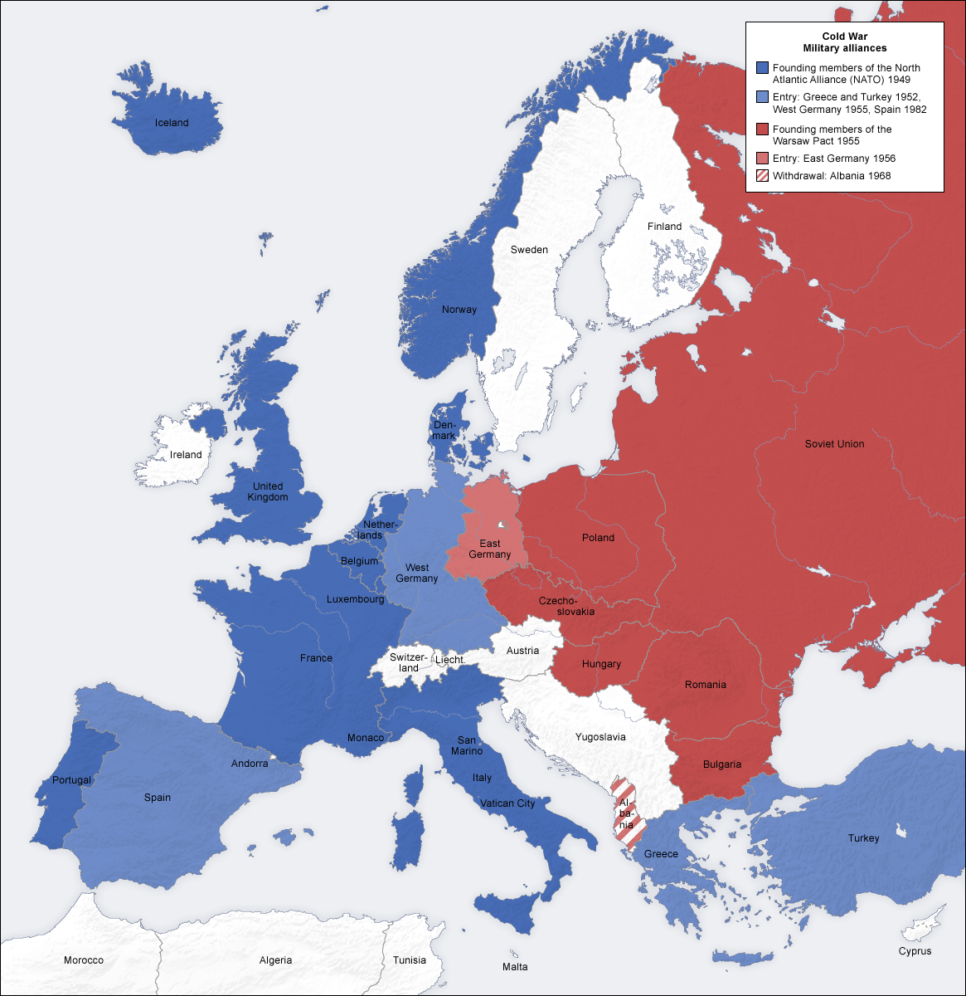

Slide 10
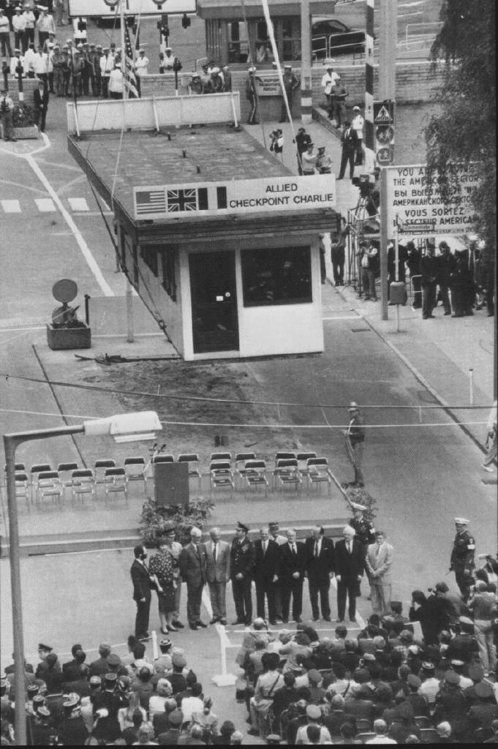
Events during the Cold War that could have erupted into all-out war
Berlin Blockade (1948-49)
COMECON and NATO (1949)
Korean War (1950-1953)
Warsaw Pact (1955)
Berlin Wall (1961)
Cuban Missile Crisis (1962)
Vietnam War (1957-1975)
Invasion of Afghanistan (1979-1989)
Iran (1980s)

Slide 11
We didn’t start the fire

Slide 12
"We Didn't Start The Fire" by Billy Joel
Harry Truman, Doris Day, Red China, Johnnie Ray South Pacific, Walter Winchell, Joe DiMaggio Joe McCarthy, Richard Nixon, Studebaker, television North Korea, South Korea, Marilyn Monroe Rosenbergs, H-Bomb, Sugar Ray, Panmunjom Brando, "The King and I", and "The Catcher in the Rye" Eisenhower, vaccine, England's got a new queen Marciano, Liberace, Santayana goodbye

Slide 13
Josef Stalin, Malenkov, Nasser and Prokofiev Rockefeller, Campanella, Communist Bloc Roy Cohn, Juan Peron, Toscanini, dacron Dien Bien Phu and "Rock Around the Clock" Einstein, James Dean, Brooklyn's got a winning team Davy Crockett, "Peter Pan", Elvis Presley, Disneyland Bardot, Budapest, Alabama, Khrushchev Princess Grace, "Peyton Place", trouble in the Suez CHORUS

Slide 14
Little Rock, Pasternak, Mickey Mantle, Kerouac Sputnik, Chou En-Lai, "Bridge on the River Kwai" Lebanon, Charles de Gaulle, California baseball Starkweather, homicide, children of thalidomide Buddy Holly, "Ben-Hur", space monkey, Mafia hula hoops, Castro, Edsel is a no go U2, Syngman Rhee, payola and Kennedy Chubby Checker, "Psycho", Belgians in the Congo

Slide 15
Hemingway, Eichmann, "Stranger in a Strange Land" Dylan, Berlin, Bay of Pigs Invasion "Lawrence of Arabia", British Beatlemania Ole Miss, John Glenn, Liston beats Patterson Pope Paul, Malcolm X, British politician sex JFK, blown away, what else do I have to say

Slide 16
Birth control, Ho Chi Minh, Richard Nixon, back again Moonshot, Woodstock, Watergate, punk rock Begin, Reagan, Palestine, terror on the airline Ayatollolah's in Iran, Russians in Afghanistan "Wheel of Fortune" , Sally Ride, heavy metal suicide Foreign debts, homeless vets, AIDS, Crack, Bernie Goetz Hypodermics on the shore, China's under martial law Rock and Roller Cola Wars, I can't take it anymore

